Slide 1


Have you installed Python on your PC?
If YES click Here
If NO click Here

Slide 2
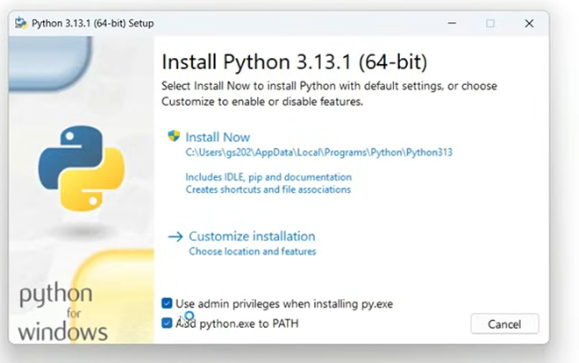
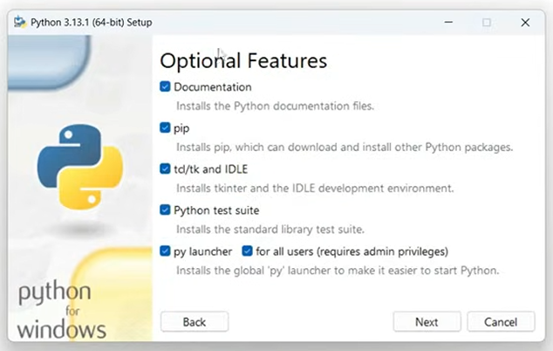
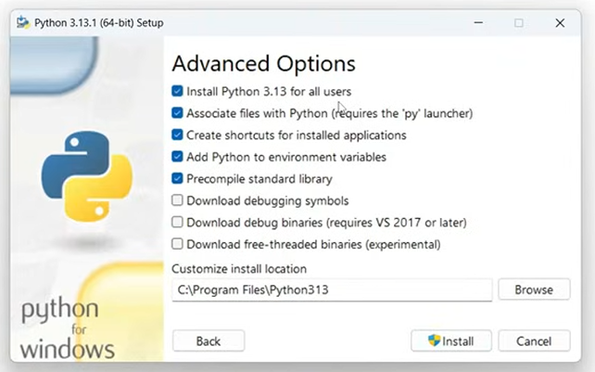
Steps to Enable Python (for users who DON’T HAVE Python installed)
Step 1: Download the latest Python here
Step 2: Run the installer
Step 3: Make sure you ticked these TWO
Step 4: Click Customize Installation
Step 5: Ensure all Optional Features are ticked, then click Next
Step 6: Make sure these Advanced Options are ticked
Step 7: Click Install
Once all is done, let’s start to call the API! Click Here

Slide 3
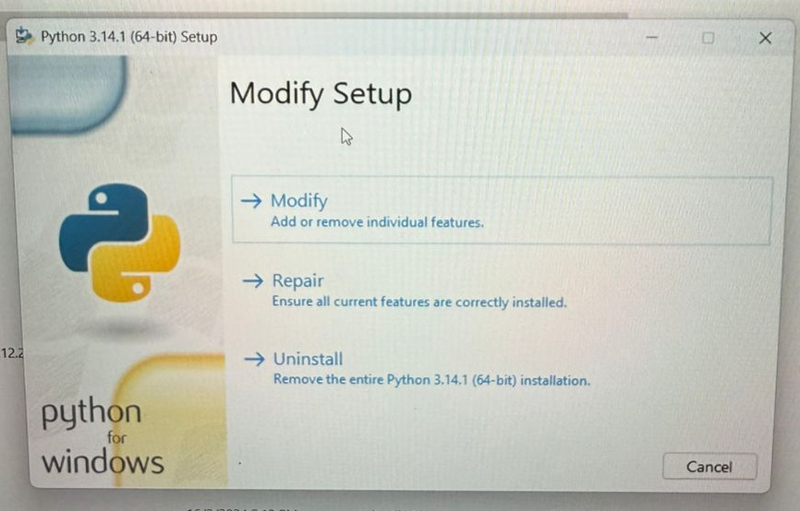
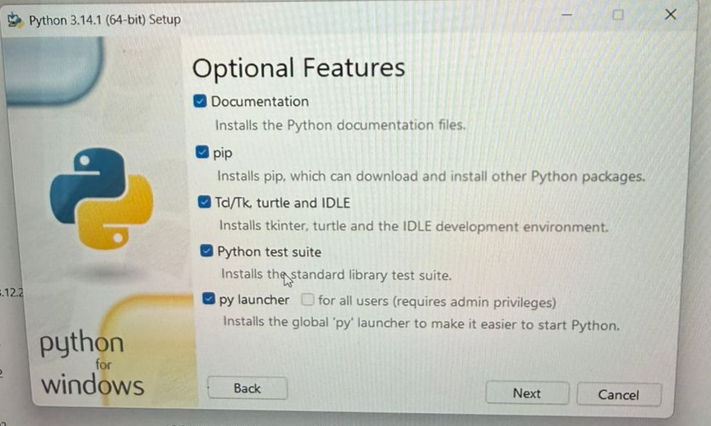
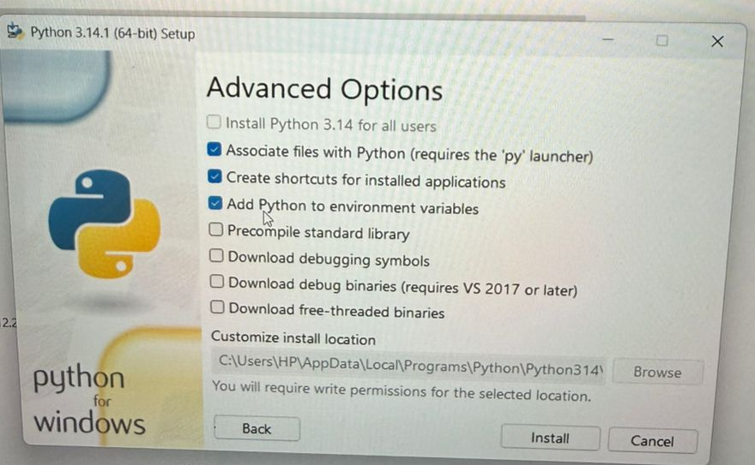
Steps to Enable Python (for users who HAVE Python installed)
Step 1: Go to your File Explorer and find your Python installer
Step 2: Re-run the Python installer
Step 3: Click Modify Python
Step 4: Ticked all Optional Features, then click Next
Step 5: Ticked these Advanced Options, then Install
Once all is done, let’s start to call the API! Click Here

Slide 4
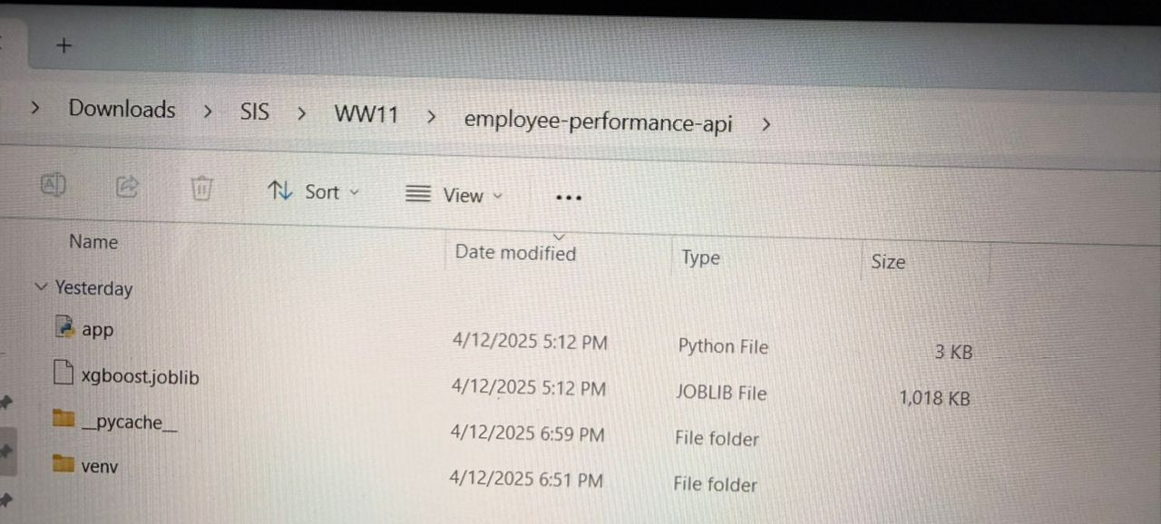
Steps to Call the API to Run Analysis on our Website
Step 1: Download our employee-performance-api folder
Step 2: Open Command Prompt
Step 3: Run the command below in Command Prompt 1-by-1
cd Copy the Path of the employee-performance-api folder that contains app.py and the joblib file.
python -m venv venv
venv\Scripts\activate.bat
pip install fastapi uvicorn scikit-learn xgboost joblib numpy pandas python-multipart
uvicorn app:app –reload
Step 4: Now, you can navigate to the website and upload the file for predictions

